Slide 1


AUTOMATED SKIN DISEASE DETECTION USING DEEP LEARNING
Devadarshini P 2nd BSc Data Science, Kumaraguru College of Liberal Arts and Science

Slide 2
INTRODUCTION
Skin diseases impact millions worldwide, requiring timely and accurate diagnosis.
Limited access to dermatologists, especially in remote areas, delays treatment.
Traditional diagnostic methods are time-consuming and prone to human error.
AI-driven skin disease detection enhances accuracy and accessibility.
Deep learning models like CNNs offer automation, precision, and scalability.
OBJECTIVE
AI-based skin disease detection system
High-accuracy classification using CNNs training over 20,000 images
Streamlit-based web application for diagnosis
Faster diagnosis for early treatment
Robustness against image variations
Support for healthcare professionals

Slide 3
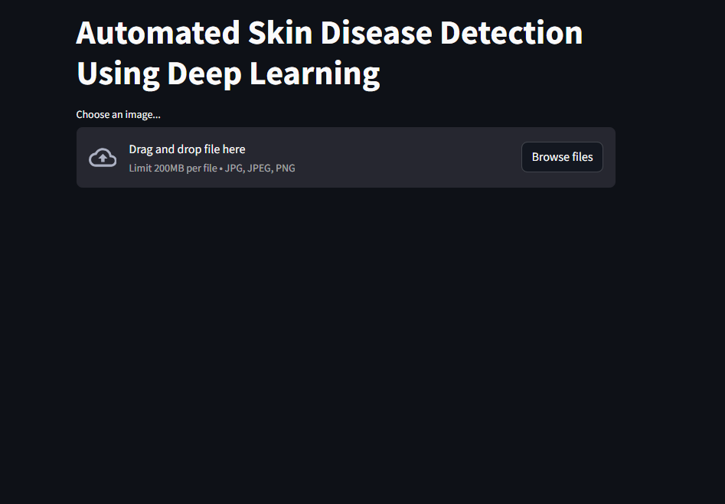
METHODOLOGY
Data Collection & Preprocessing:
Gathered a dataset of 20,000+ dermatological images.
Applied data augmentation (rotation, flipping, zooming) for better model generalization.
Resized and normalized images for uniform input.
Model Selection & Training:
Chose EfficientNetB4 CNN architecture for optimal performance.
Trained the model using TensorFlow and Keras.
Used categorical cross-entropy as the loss function.
Optimized with Adam optimizer for faster convergence.
Model Evaluation & Performance Metrics:
Evaluated using accuracy, precision, recall, and F1-score.
Achieved over 93% accuracy in classification.
Performed confusion matrix analysis for class-wise performance.
Web Application Development:
Developed an interactive interface using Streamlit.
Enabled users to upload skin images for instant
classification.
Provided real-time predictions with confidence scores.

Slide 4
KEY FINDINGS
High Accuracy: Achieved over 93% accuracy in skin disease classification using EfficientNetB4 CNN.
Fast & Automated Diagnosis: Reduced diagnostic time compared to traditional methods, enabling quick assessments.
Improved Generalization: Data augmentation techniques enhanced model robustness across different image conditions.
User-Friendly Web Interface: Developed a Streamlit-based application for real-time skin disease detection.
Scalability & Accessibility: Cloud deployment allows remote access, benefiting patients and healthcare professionals.
Reliable Performance: Evaluated using precision, recall, and F1-score, ensuring trustworthy predictions.
Early Detection Impact: AI-driven classification aids in early diagnosis, potentially preventing severe conditions.

Slide 5
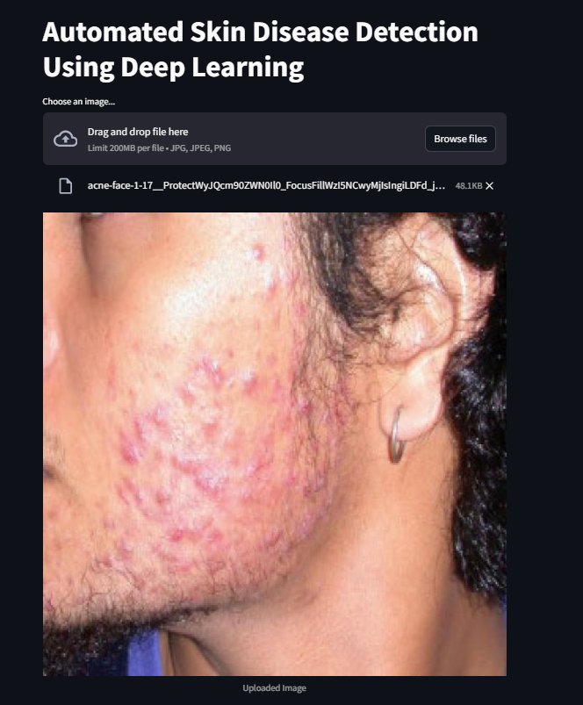
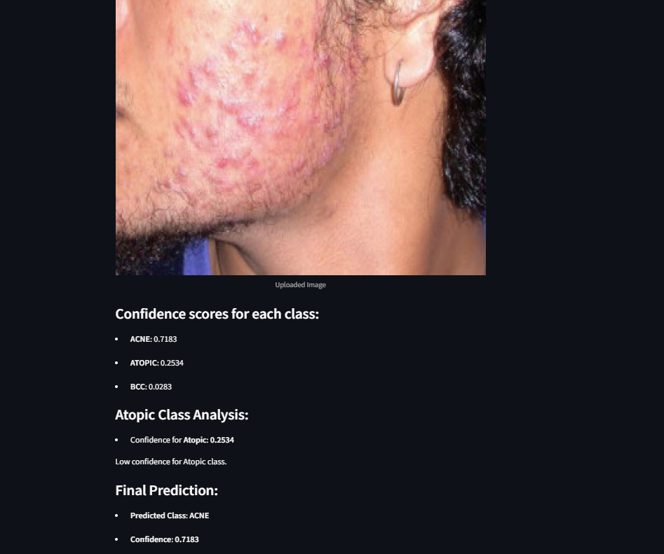

Slide 6
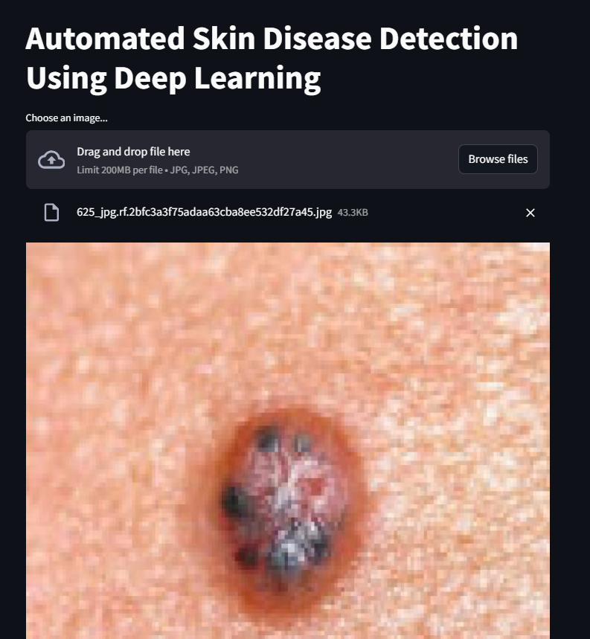
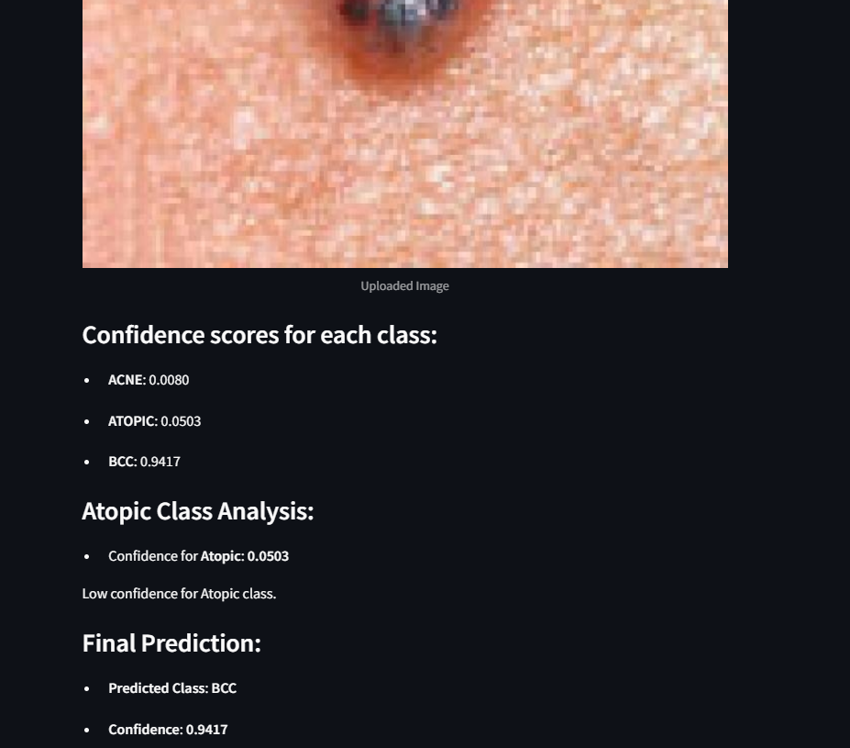

Slide 7
APPLICATIONS AND IMPLICATIONS
APPLICATIONS
Dermatology Clinics & Hospitals – Assists doctors in diagnosing skin diseases quickly and accurately.
Mobile Health Apps – Can be integrated into smartphone apps for self-assessment and early detection.
Telemedicine & Remote Healthcare – Enables remote diagnosis for patients in underserved areas.
Pharmaceutical Industry – Helps in drug research and personalized treatment recommendations.
IMPLICATIONS
Reduces the risk of severe skin conditions by enabling timely intervention.
It bridges the gap for patients in remote areas with limited dermatologists.
Minimizes the need for expensive diagnostic procedures.
AI assists doctors by filtering non-critical cases and reduces their workload.

Slide 8
FUTURE SCOPE
Expand Disease Coverage – Train the model to detect a wider range of skin diseases.
1
Integrate Explainable AI (XAI) – Improve transparency by explaining AI decisions to doctors and patients.
2
Enhance Mobile & IoT Integration – Develop a real-time diagnostic tool for wearable devices and smartphones.
3

